Slide 1
Introduction to the Anacostia River: An urban case study

Slide 2
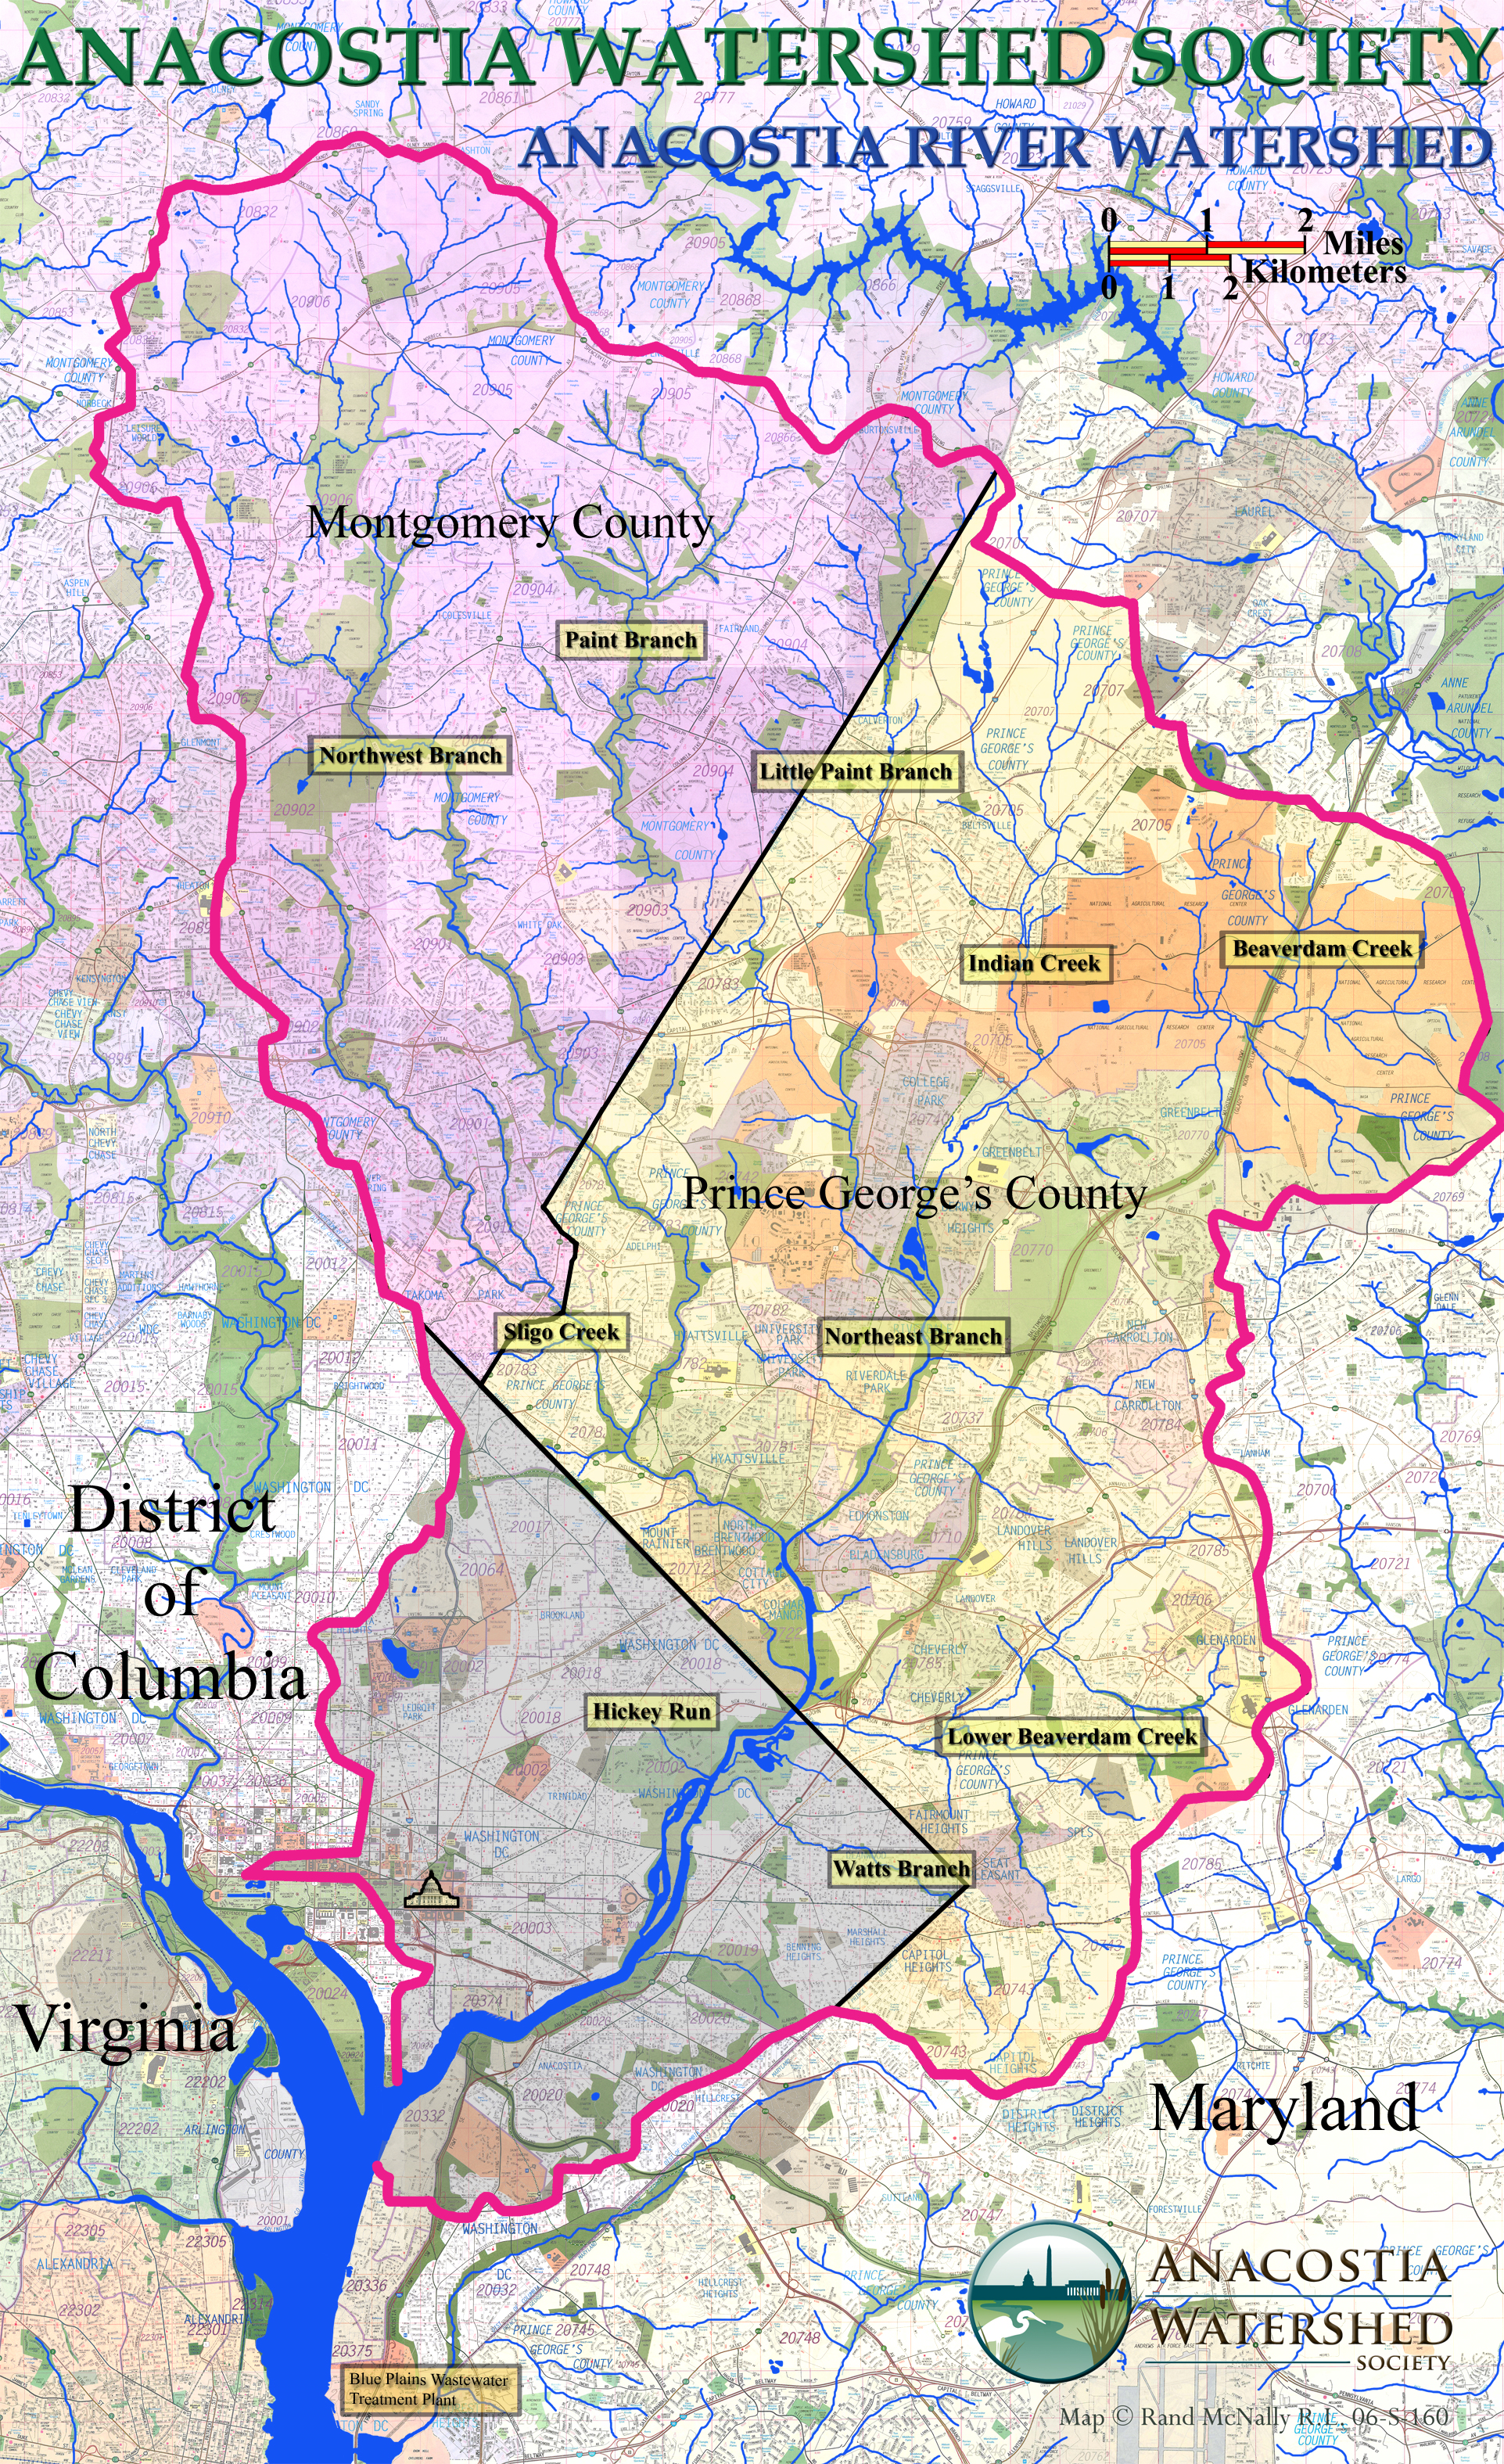
The Anacostia River Watershed

Slide 3
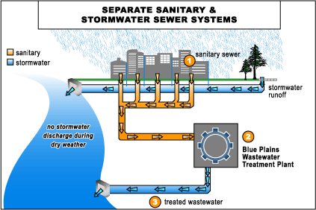
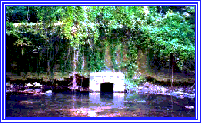
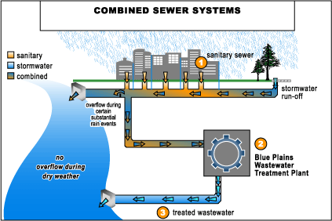

Slide 4
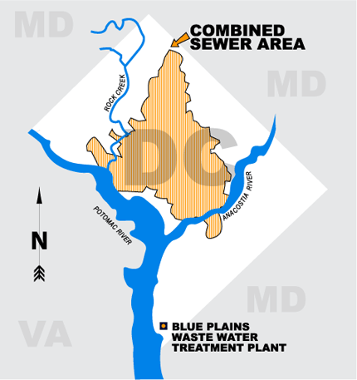

Slide 5
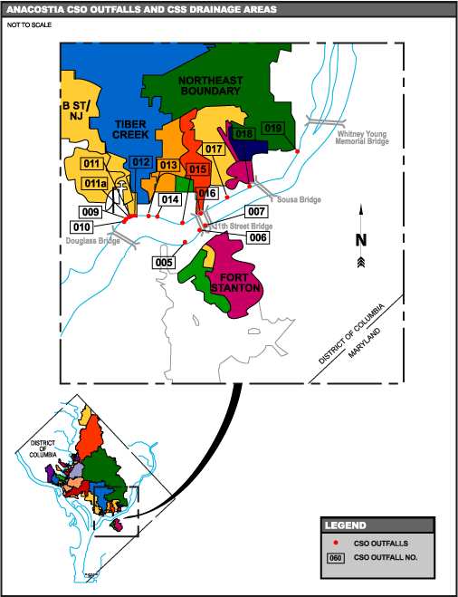

Slide 7
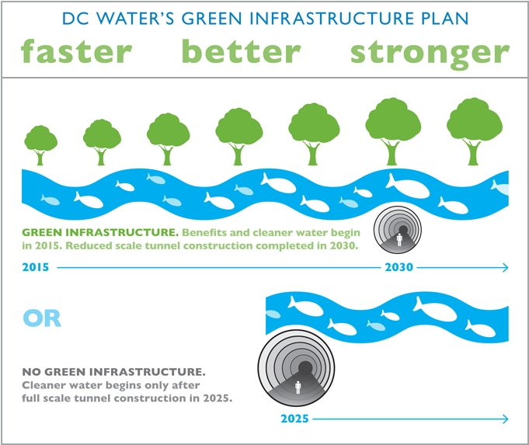

Slide 8

DC’s bag law – economic consequences

Slide 9
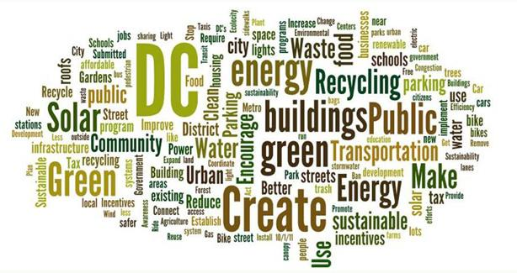
Sustainable DC Plan

Slide 10
Anacostia River Economics -
50,000 people live within 10 minutes walk
River restoration/clean up adds millions to value of homes
Increased wealth = more amenities
Amenities attract companies, jobs
Better quality of life
Fewer illnesses from pollution = less medical costs

